Slide 1
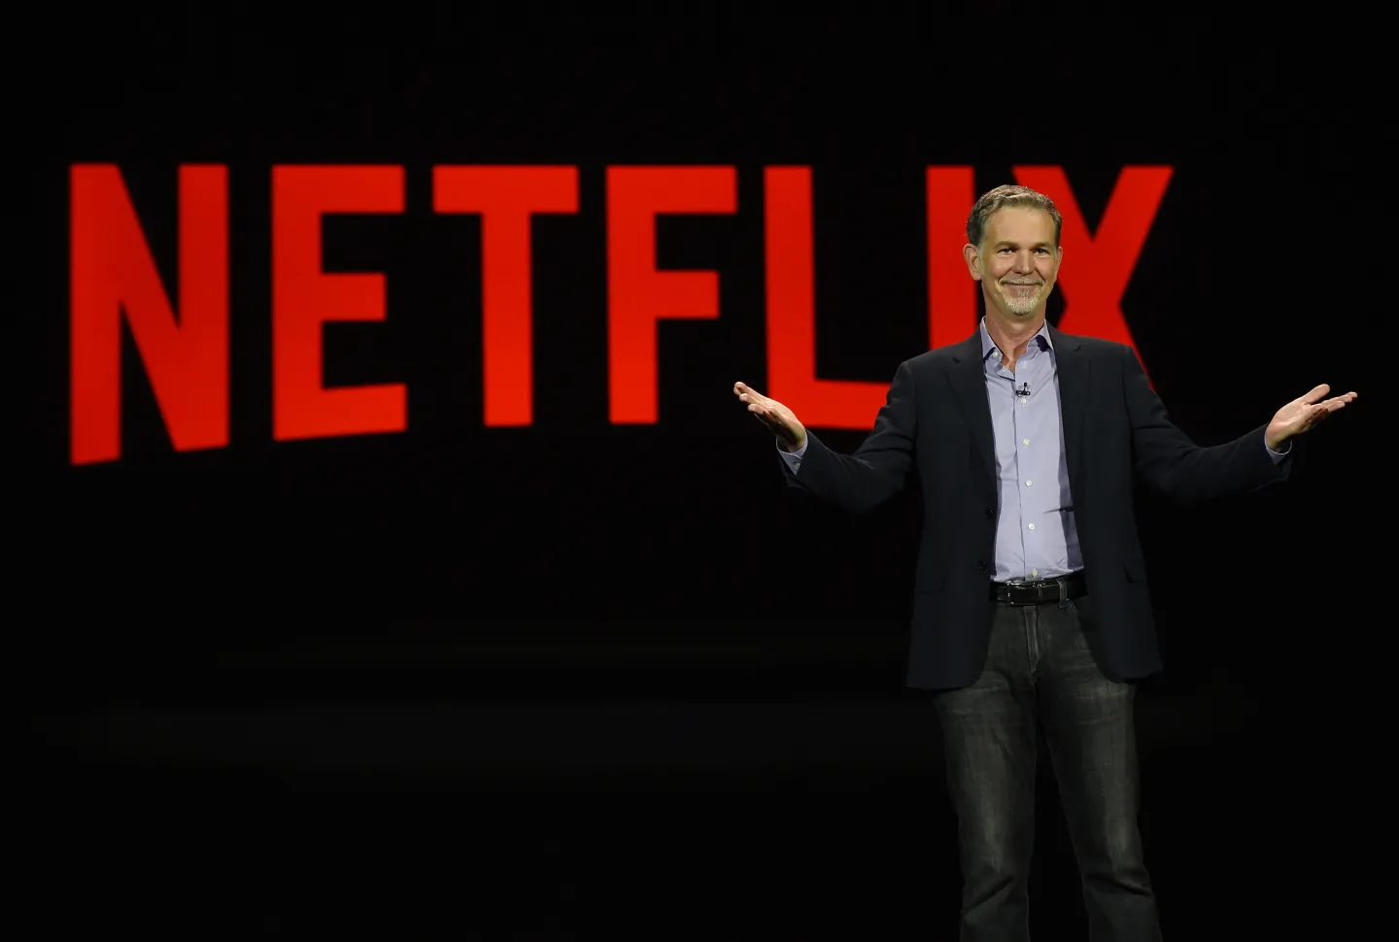
Reed Hastings
Reed Hastings was born on October 8, 1960, in Boston, Massachusetts. He holds a Bachelor’s degree in Mathematics from Bowdoin College and a Master’s degree in Computer Science from Stanford University.
In 1991, he founded his first company, Pure Software, which developed debugging tools for software developers. After the company’s acquisition in 1997, Hastings began exploring new opportunities—one of which led to the founding of Netflix.

Slide 2
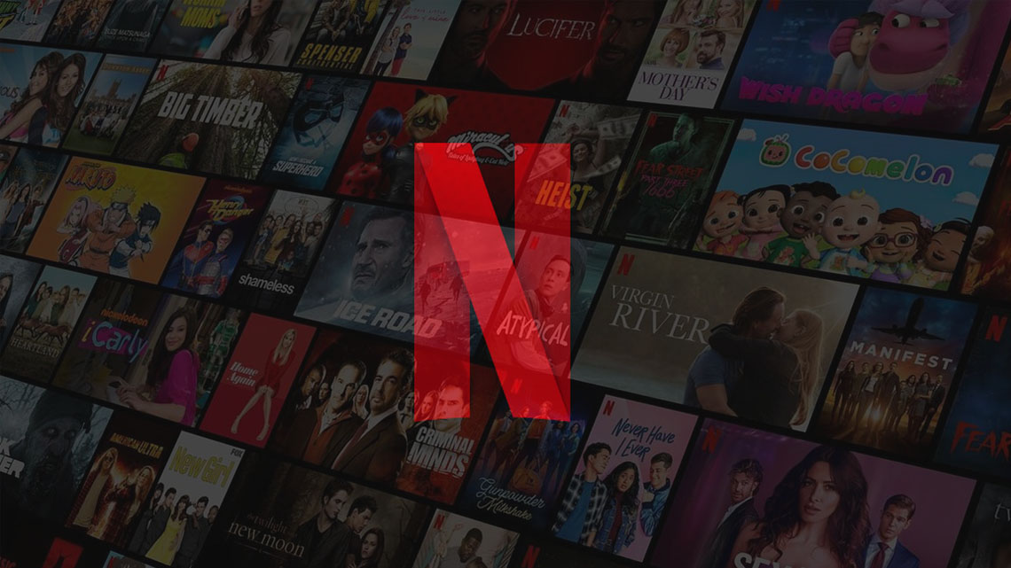
Founding and Early Growth of Netflix
Reed Hastings co-founded Netflix in 1997 alongside Marc Randolph in California. The idea was inspired by Hastings’ frustration with a late fee he incurred from a video rental store. This experience prompted him to envision a more customer-friendly rental model—one that would eliminate late fees altogether.
Netflix launched in 1998 as an online DVD rental service. Unlike traditional video rental stores, Netflix offered customers the convenience of renting DVDs through its website and having them delivered by mail. In 1999, the company introduced a monthly subscription plan that allowed users to rent unlimited DVDs with no return deadlines. This innovation laid the foundation for Netflix’s success and helped it stand out in a competitive market dominated by Blockbuster.

Slide 3
Initial Revenue Model of Netflix
In its early years, Netflix experimented with different payment models:
1998 – Pay-Per-Rental: Initially, customers paid individually for each DVD rented.
1999 – Subscription-Based Model: Netflix transitioned to a flat monthly fee for unlimited DVD rentals, removing late fees and due dates.
This shift in strategy was crucial to Netflix’s growth, as it offered a more attractive and predictable pricing model for consumers. However, profitability was a challenge during these years due to high operational costs related to logistics and mailing. To raise funds and expand, Netflix went public in 2002.

Slide 4
Transition to Streaming and Financial Evolution
The most significant transformation in Netflix’s business model came in 2007, when it introduced video streaming services. This allowed users to watch content instantly via the internet, marking the beginning of a new era for the company.
Modern Revenue Streams and Monetization Strategies:
Subscription Tiers: Netflix now operates on a tiered subscription model based on video quality (SD, HD, 4K) and the number of simultaneous screens. Subscription prices vary by country and plan.
Original Content: Since 2013, Netflix has heavily invested in original programming, starting with hits like House of Cards. Original content helps attract and retain subscribers while reducing reliance on third-party studios.

Slide 5
Conclusion
Reed Hastings played a pivotal role in redefining the global entertainment industry. From humble beginnings as a DVD rental service, Netflix evolved into one of the world’s leading streaming platforms through strategic innovation and adaptability. Hastings' leadership and vision enabled the company to successfully transition from physical media to digital streaming, while continuously evolving its financial model to meet the demands of a global audience.
Though Reed Hastings stepped down as CEO in 2023, he remains actively involved with Netflix as Executive Chairman, continuing to influence the direction of the company he helped create.

